Slide 1
3D Model Structural Viability Assistant
Gabriel Donnan

Slide 2

Agenda
Rationale
State of the Art
Methods + Results
Future Plans
Questions

Slide 3

Rationale
- Anyone can use Blender
- Not everyone can afford existing model analysis software
> Current options range from £5000 upwards
- Blender does not currently have a method of model analysis, despite a normally rich feature suite.
- This tool would mean anyone can see how their model would behave free of charge

Slide 4
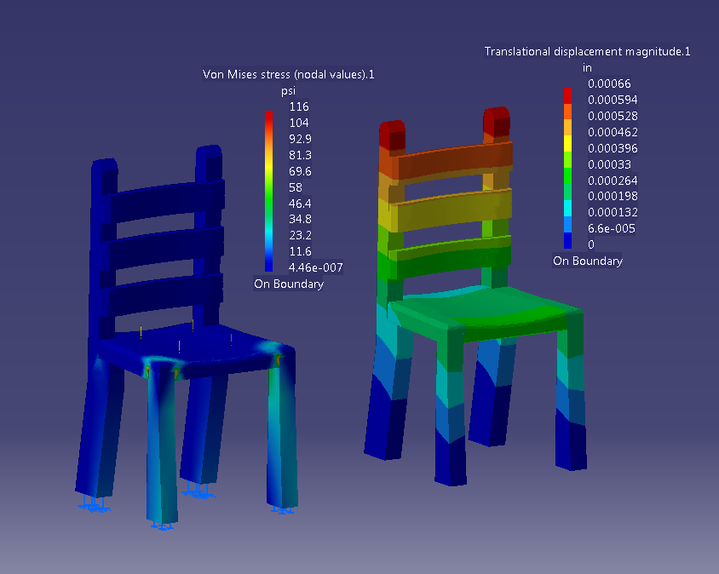
Why 3D Analysis?
- Large scale manufacturing companies use it but why should we?
- Smaller designers or personal use:
> Furniture
> DIY Projects
> etc.
- Smaller scale designers or builders can save on materials and avoid more accidents with material analysis.
http://kevanelliscatiaportfolio.weebly.com/uploads/5/1/9/2/51924425/9995081_orig.png

Slide 5

State of the Art
- Finite element analysis the overwhelming technique used
> Companies like Autodesk, SimScale, etc.
- Finite Element Method:
> Computational model to approximate partial differential equations
> Discretizes a mesh into simple shapes, i.e. “elements”.

Slide 6
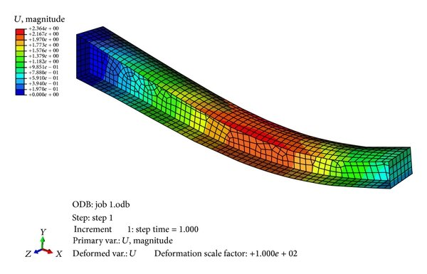
Finite Element Analysis Contd.
- How does finite element analysis work?
> Model split into finite elements
> Finite elements iterated over
> For each element stiffness matrix found
> With some math from here we can then find displacement + forces applied
> This can be done with 1, 2 or 3 dimensional elements
https://www.researchgate.net/publication/273180368/figure/fig5/AS:1088632035258371@1636561511281/Finite-element-model-of-tapered-beam.jpg

Slide 7
Current Methodology
1) Model read in from Blender
2) Model reduced to vertices, edges and faces
2)a) If multiple models exist they are linked together to form one cohesive mesh
3) Nodes each have random forces applied to them for demonstration and testing purposes
4) Each edge is treated as a 1 dimensional finite element (like a thin bar would be)
5) Analysis is performed on the full system

Slide 8
Topic one
Subtitle

Slide 9
Chart

Slide 10
Table
 | Category 1 | Category 2 | Category 3 | Category 4
Item 1 | 4.5 | 2.3 | 1.7 | 5
Item 2 | 3.2 | 5.1 | 4.4 | 3
Item 3 | 2.1 | 1.7 | 2.5 | 2.8
Item 4 | 4.5 | 2.2 | 1.7 | 7

Slide 11

The way to get started is to quit talking and begin doing.
Walt Disney

Slide 12
Team
Name Title
Name Title
Name Title
Name Title

Slide 13
Timeline
Title
To start a presentation, go to the Slide Show tab, and select From Beginning.
Title
To display Presenter view, in Slide Show view, on the control bar at the bottom left select the three dots, and then Show Presenter View.
Title
During your presentation, the speaker notes are visible on your monitor, but aren't visible to the audience.
Title
The Notes pane is a box that appears below each slide. Tap it to add notes.
Title
If you don’t see the Notes pane or it is completely minimized, click Notes on the task bar across the bottom of the PowerPoint window.

Slide 14
Title
Subtitle
Subtitle
Add text, images, art, and videos.
Add transitions, animations, and motion.
Save to OneDrive, to get to your presentations from your computer, tablet, or phone.
Open the Design Ideas pane for instant slide makeovers.
When we have design ideas, we’ll show them to you right there.

Slide 15
Title
Subtitle
Subtitle
Subtitle
Add text, images, art, and videos.
Add transitions, animations, and motion.
Save to OneDrive, to get to your presentations from your computer, tablet, or phone.
Open the Design Ideas pane for instant slide makeovers.
When we have design ideas, we’ll show them to you right there.
This PowerPoint theme uses its own unique set of colors, fonts, and effects to create the overall look and feel of these slides.
PowerPoint has tons of themes to give your presentation just the right personality.

Slide 16



Summary
With PowerPoint, you can create presentations and share your work with others, wherever they are. Type the text you want here to get started. You can also add images, art, and videos on this template. Save to OneDrive and access your presentations from your computer, tablet, or phone.

Slide 17



Any Questions?
Gabriel Donnan
gd517@bath.ac.uk
https://github.com/gabedonnan/Blendiforce-SVA

